Slide 1


PMDL Project
Email Spam Detection
Dalia Waleed ElNagar
Mariam Fawzy
Basant Abdelaal

Slide 2
Outline
Problem and Motivation
Dataset
Data Analysis and Feature Engineering
Preprocessing Data
Training
Results
Conclusion
Recommendation

Slide 3
The Problem

Slide 4
Rising Spam Emails. What we classify as spam:
Advertising and Promotions
Online Dating
Motivation:
The growing volume of spam Emails.
Protecting devices from virus wrapped emails

Slide 5
Spam Ham Data Set
Solving Unbalance:
Combining data sets and removing duplicates
Datasets used:
https://www.kaggle.com/karthickveerakumar/spam-filter : 24% Spam
https://www.kaggle.com/venky73/spam-mails-dataset : 29% Spam
Combined and Balanced Dataset:
47% Spam

Slide 6
Literature review
The literature for our problem was mainly applying:
Machine Learning Models (SVM, Linear Regression, etc.)
CNN
RNN
LSTM
BERT with NN

Slide 7
Analysis and Feature Engineering

Slide 8
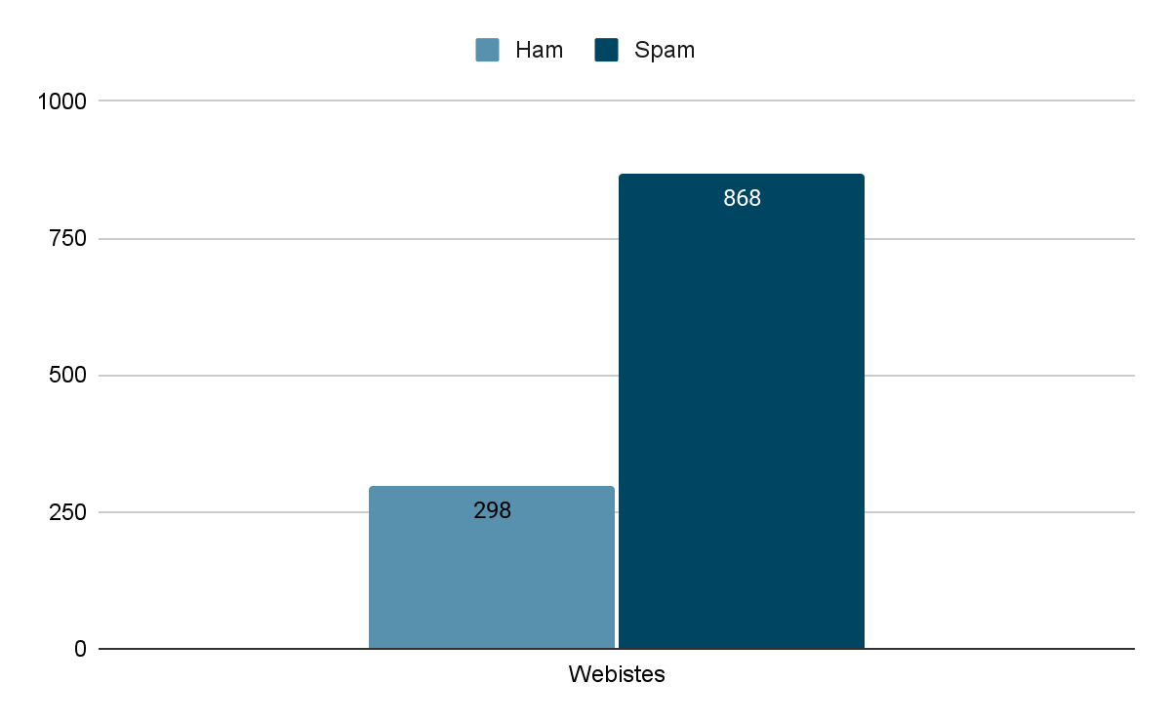
Presence of Websites
01
Motivation:
Most of spam emails contains links to other websites for further communication.
Analysis:
1

Slide 9
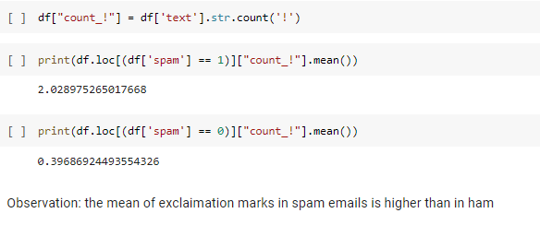
Exclamation Mark Count
02
Motivation:
The excitement in spam emails are mostly accompanied by exclamation marks
Analysis:
1

Slide 10
Sentiment Analysis
03
Motivation:
The sentiment in spam emails is mostly biased towards positiveness and excitement to convince the reader with the content.
Sentiment Scores:
Polarity: lies in the range of [-1,1] → 1: positive and -1: negative
Subjectivity: lies in range of [0, 1] →
1: Subjective (emotion or judgment)
0: Objective (Factual Info)

Slide 11
Data Preprocessing

Slide 12
Only Words
01
In this step:
Expanding Contractions
Removing Newlines and Tabs
Remove all characters other than alphabet
Substitute any number of space with one space only
Remove integers
Lower characters
Method:
RegEx
Python Contractions Package
1

Slide 13
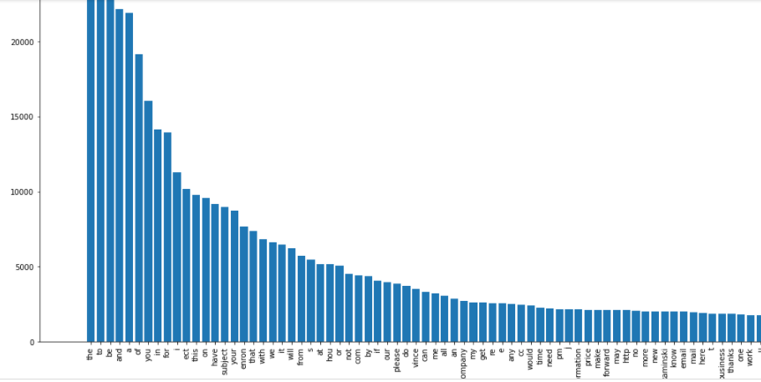
Stemming
02
In this step:
Segmenting The text
Method: split function in python
Lemmatization
Method: WordNetLemmatizer
Dictionary
1

Slide 14
Removing Stop Words and least frequency words
03
In this step:
Removing Stop Words
Method: nltk.corpus + single letters
Least Frequency
Method: To focus on the important words, very low frequency words (<5) = 39445 words were removed

Slide 15
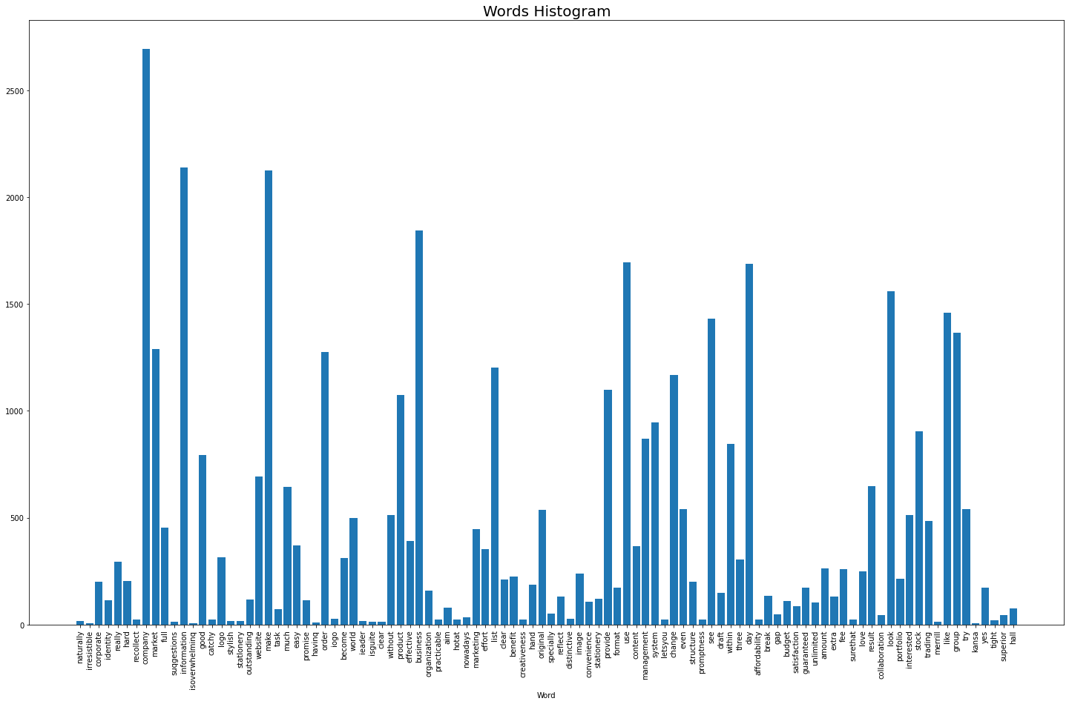
Final Dictionary

Slide 16
Tokenization
& Embedding
04
In this step:
To further use the dataset in the models, we used Keras for tokenization and Embedding.

Slide 17
The Training

Slide 18
Training
1
Models:
CNN
Combination of CNN and sentiment Analysis
Combination of CNN and features extracted
LSTM
Combination of LSTM and sentiment Analysis
Combination of LSTM and features extracted

Slide 19
Hyperparameters tuning
Parameters:
Loss Function
Optimizer
Activation Function
Embedding Output
Dropout Ratio

Slide 20
The Results

Slide 21
Results:
 | LSTM | CNN
No extra features | 96.9% | 96.3%
Sentiment | 97.4% | 96.3%
Website Feature | 97.2% | 95.4%
Exclamation Count Feature | 97.1% | 95.3%

Slide 22
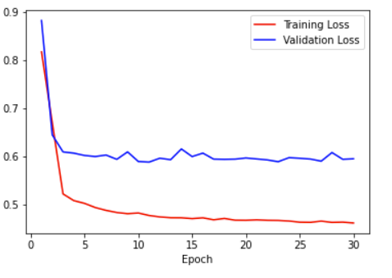
Plotting the training vs. validation loss of LSTM with sentiment analysis:

Slide 23
Conclusion

Slide 24
LSTM
Sentiment Analysis
Best Model

Slide 25
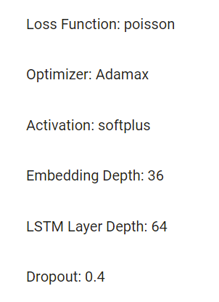
Conclusion
Best parameters to train the LSTM:

Slide 26
Recommendations for Future Work

Slide 27
Future Work
People who will complete this project may do the following:
Search for a bigger dataset or combine different datasets
Make combinations of different models
Use Bert for the embedding

Slide 28


